Slide 1
Tycho Brahe / Johannes Kepler Planetary Motion
Astro Chapter 3-3

Slide 2
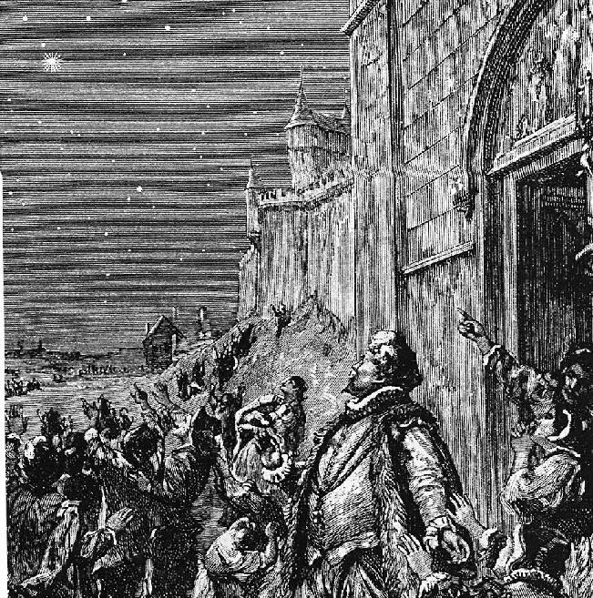
As astronomers struggled to understand the place of the Earth in the universe, they also faced the problem of planetary motion.

Slide 3
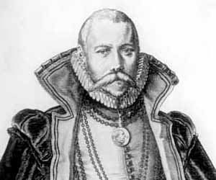
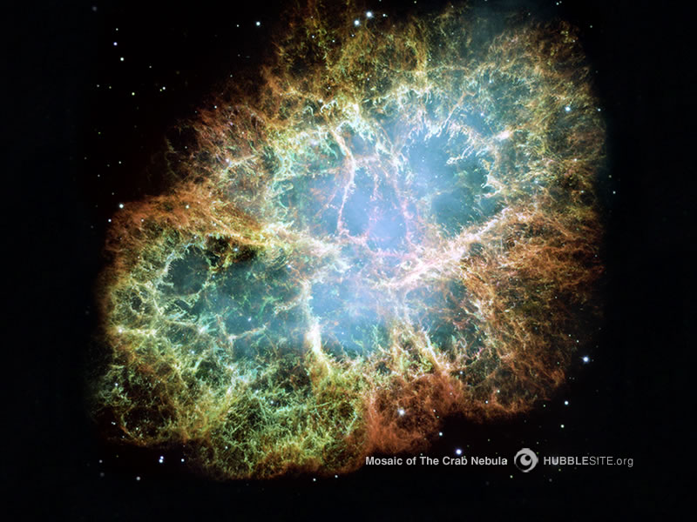
Tycho Brahe
A Danish nobleman
In 1572 he studied a “new star” that had appeared in the sky (now known as Tycho’s supernova), and concluded that it was a new star in Aristotle’s “Unchanging stary sphere”.

Slide 4
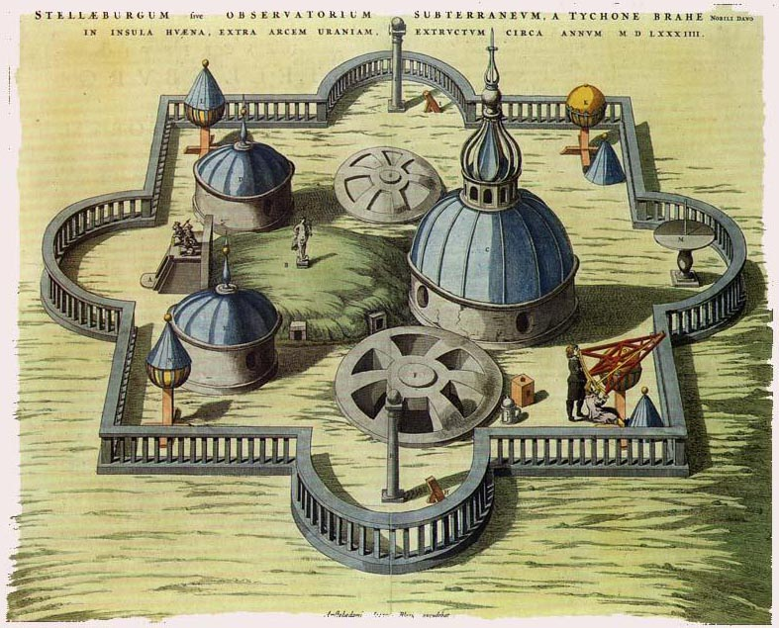
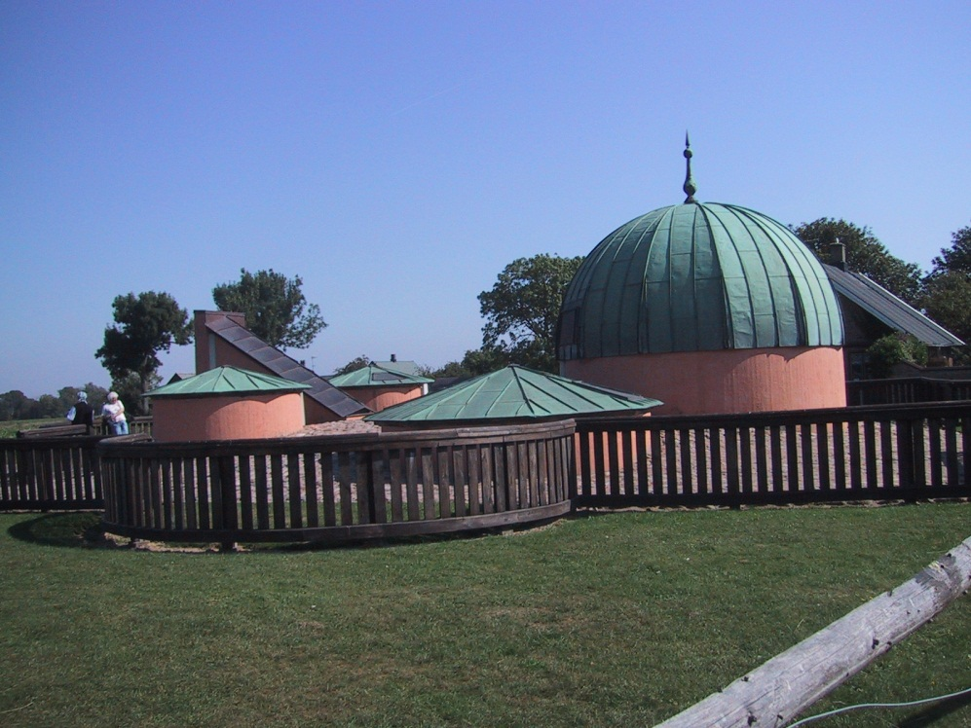
This posed the issue of, are the heavens perfect and unchanging or not?
Through more years of work, Tycho became honored by the King of Denmark, and was given an island, on which Tycho built an observatory to continue studying stars and planetary positions and movements.

Slide 5
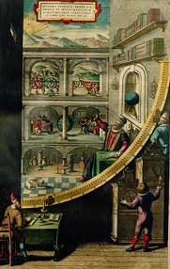
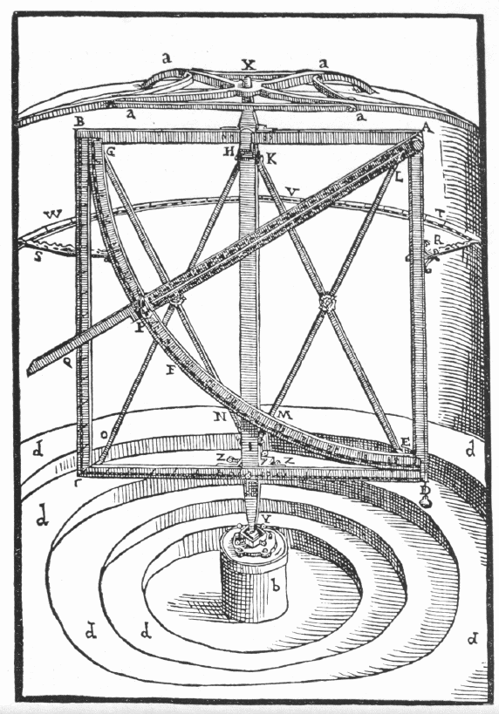
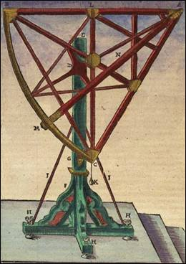
No telescopes at that time, so all observations (about 20 years worth) were with the naked eye.
These meticulous observations were his major accomplishment and vital to later astronomers.

Slide 6
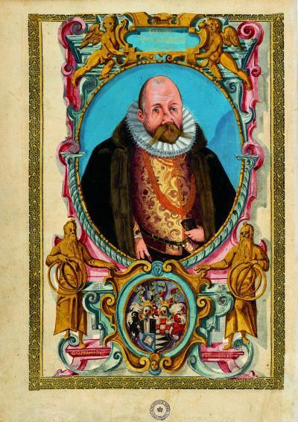
Tycho was offered the position of Imperial Mathematician to the Holy Roman Emperor Rudolph II in Prague.
Tycho hired a promising young assistant, Johannes Kepler, and in 1601 just before Tycho’s death, Kepler became Tycho’s replacement as Imperial Mathematician.

Slide 7
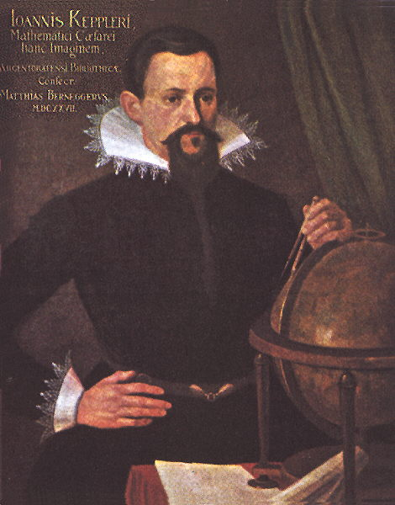
Johannes Kepler
Born in 1571 into a poor farming family in what is now Germany, he was the oldest of 6 kids.
Kepler studied hard and eventually earned a college scholarship and went to Graz (Austria) to study to become a Luthern Pastor.

Slide 8
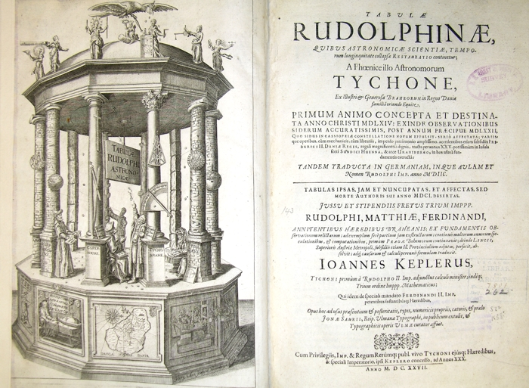
Kepler left college during his 4th year to teach and pursue his studies in math and astronomy.
In 1596 he wrote a book, Mysterium Cosmographicum, in which he tried to explain planetary motion through mathematics.

Slide 9
His work piqued the interest of Tycho Brahe, who invited Kepler to be his assistant in Prague in 1600, and replaced Tycho as Imperial Mathematician in 1601.
Kepler used Tycho’s 20+ years of work and observations in astronomy, and by 1606 had begun to formulate new laws to govern the motion of the planets.

Slide 10
Kepler’s 3 Laws of Planetary Motion
His laws are called empirical, because they describe a phenomena without trying to explain why it is happening, just that it is happening.

Slide 11
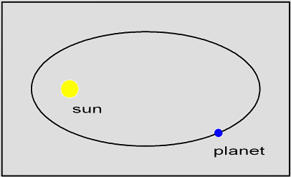
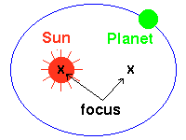
Planets move in elliptical orbits around the
sun (the sun being one of two foci)

Slide 12
Aphelion – point in the orbit when the object is farthest from the sun (also called the apogee)
Perihelion – point in the orbit when the object is closest to the sun (also called the perigee)

Slide 13
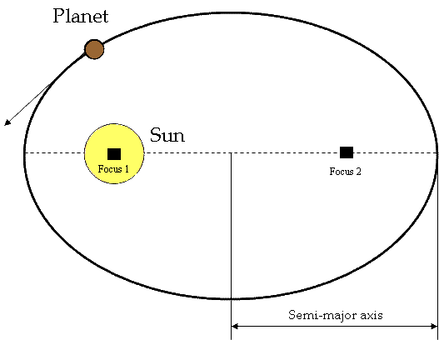
- Deviation from the circular orbits of his predessors
- By making the orbits slightly elliptical, it allows
for varying distances from the sun, and varying
speeds of motion around the sun.
-The orbits are “slightly” elliptical, and not extreme

Slide 14
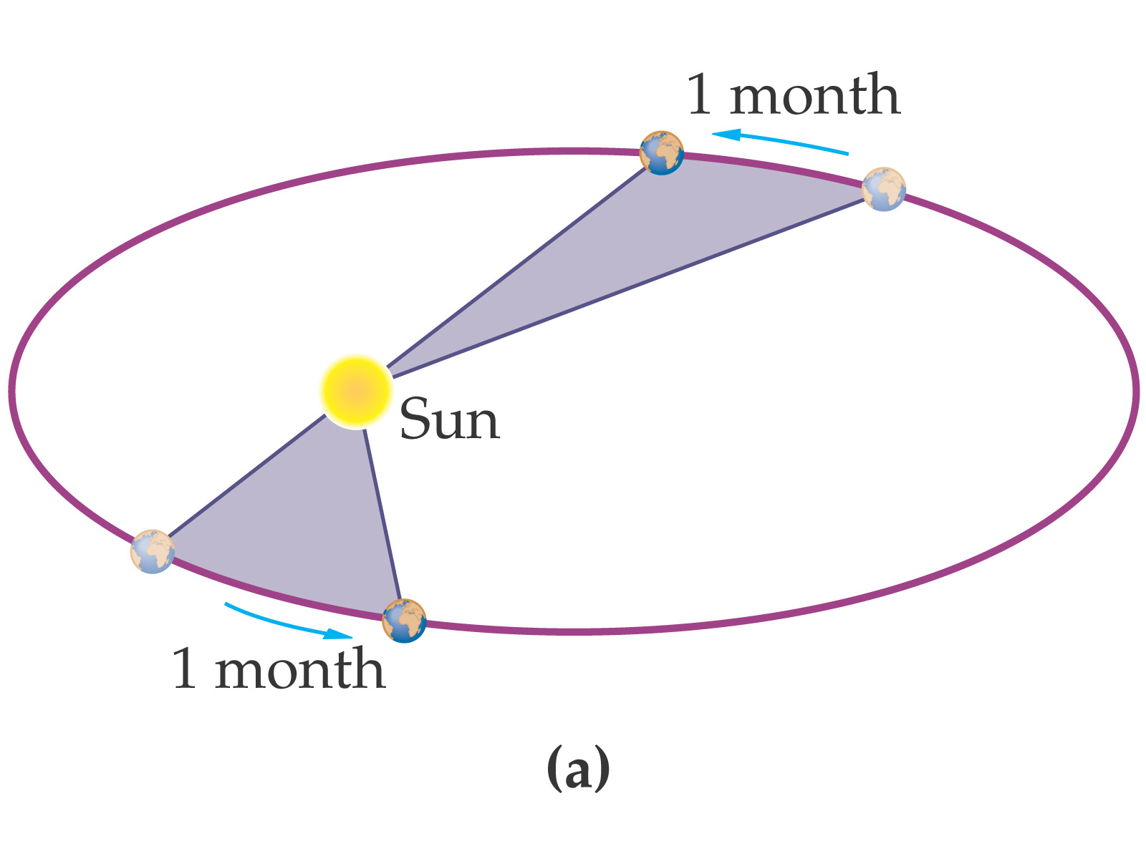
2. A line from a planet to the sun, sweeps over
equal areas in equal intervals of time.

Slide 15
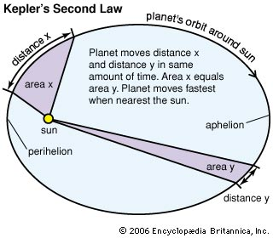
The closer to the sun the faster the planet
moves, due to effect of gravity
No longer a constant speed for planetary
revolution

Slide 16
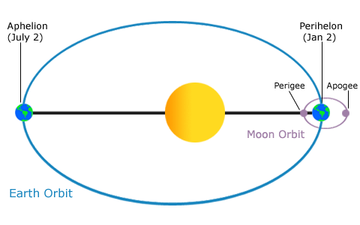
Fastest orbital speed would be at the perigee.
Slowest orbital speed would be at the apogee.

Slide 17
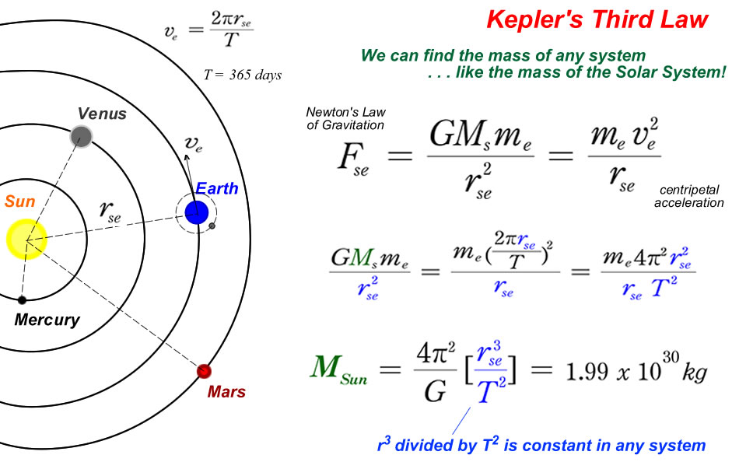
3. A planet’s orbital period squared is
proportional to its average distance from the
sun cubed.
Shows the relationship between orbital
period and distance
This is the real math behind Kepler’s laws
which supports the first two statements.

